Slide 1
Unit 6 : Non-linear Data Structure- Graph

Slide 2
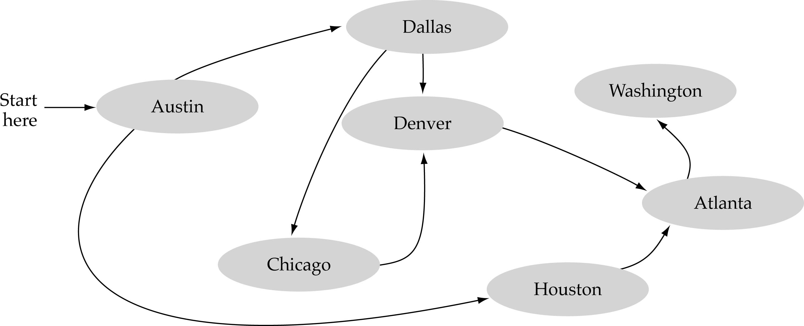
What is a graph?
A data structure that consists of a set of nodes (vertices) and a set of edges that relate the nodes to each other
The set of edges describes relationships among the vertices

Slide 3
Formal definition of graphs
A graph G is defined as follows:
G=(V, E)
V(G): a finite, nonempty set of vertices
E(G): a set of edges (pairs of vertices)

Slide 4
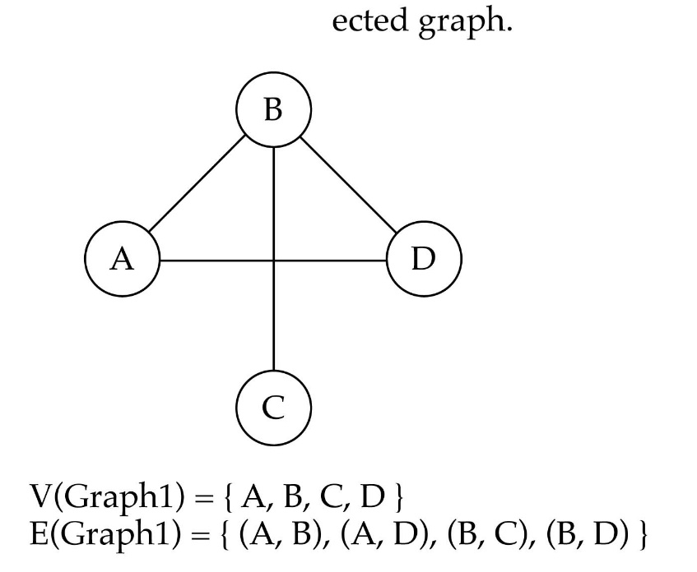
Directed vs. Undirected graphs
When the edges in a graph have no direction, the graph is called undirected

Slide 5

Directed vs. undirected graphs (cont.)
When the edges in a graph have a direction, the graph is called directed (or digraph)
Warning: if the graph is directed, the order of the vertices in each edge is important !!
E(Graph2) = {(1,3) (3,1) (5,9) (9,11) (5,7)(9,9)(11,1)}

Slide 6

Trees vs graphs
Trees are special cases of graphs!!
A connected graph with no cycles is called a tree.

Slide 7
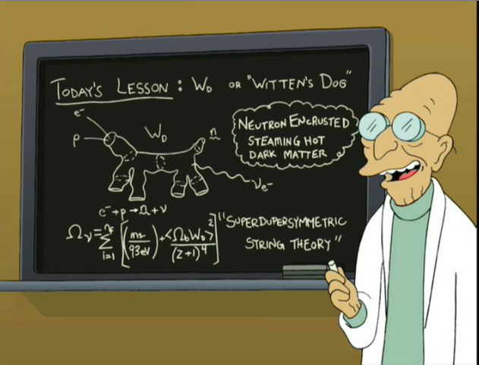
Graph Terminology
Adjacent Vertices are two vertices that are joined by an edge.
Adjacent Edges are two edges that intersect at a vertex.
Notes:
<number>

Slide 8

Adjacent nodes/Vertices: two nodes are adjacent if they are connected by an edge
5 is not adjacent to 7
7 is adjacent from 5

Slide 9
Graph Terminology
The degree of a vertex is the number of edges at that vertex.
Notes:
<number>

Slide 10
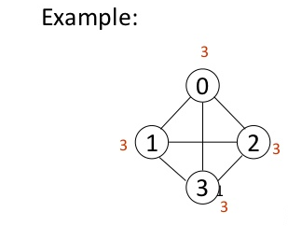
Degree, In-degree, Out-degree
Degree of every vertex is 3

Slide 11
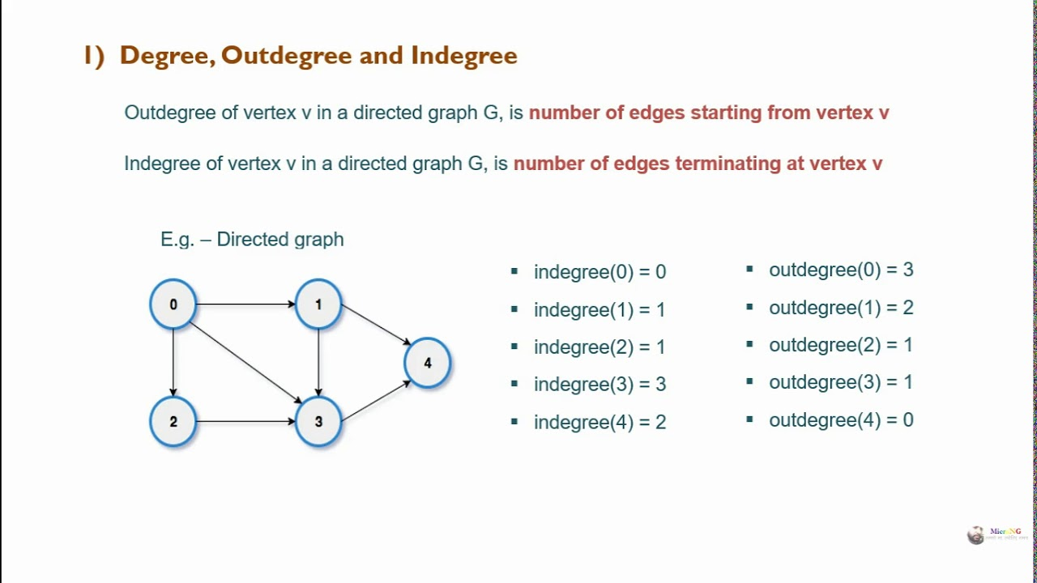
Degree, In-degree, Out-degree

Slide 12
Graph Terminology
A path is a sequence of vertices such that each vertex is adjacent to the next. In a path, each edge can be traveled only once.
The length of a path is the number of edges in that path.
Notes:
<number>

Slide 13
Graph Terminology
A path that starts and ends at the same vertex is called a circuit/cycle.
Notes:
<number>

Slide 14
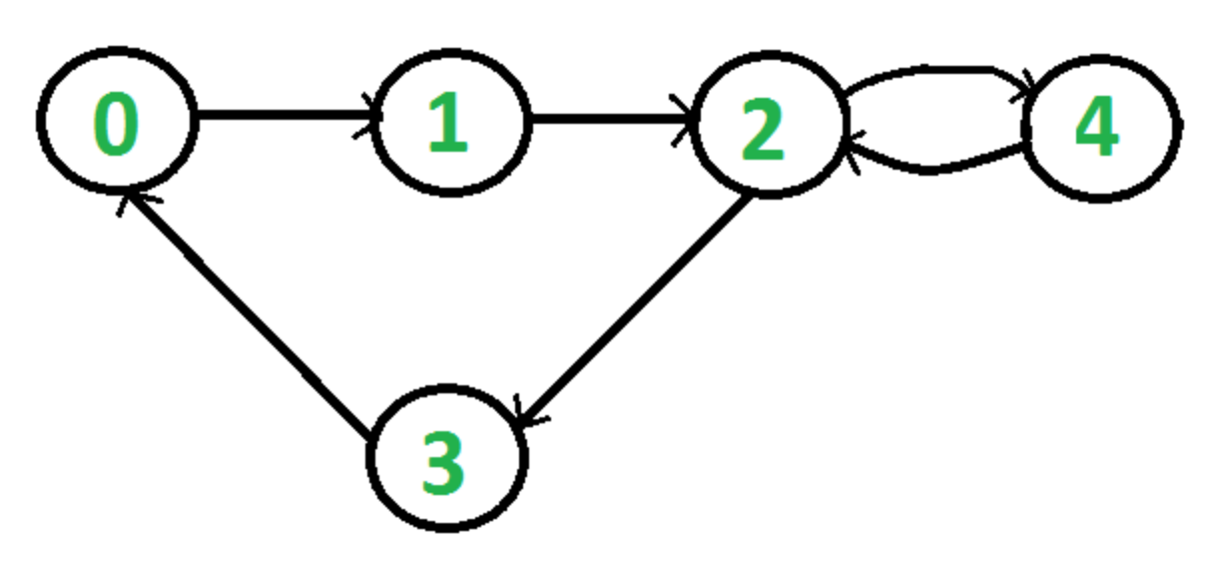
Cycle

Slide 15
Graph Terminology
A Complete graph: a graph in which every vertex is directly connected to every other vertex
Notes:
<number>

Slide 16
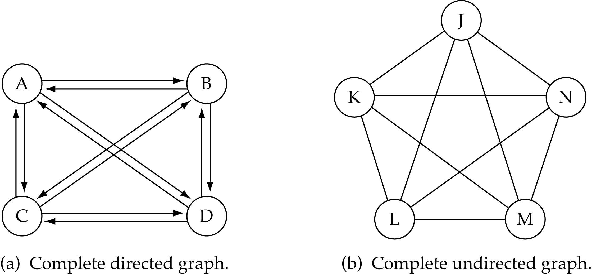
Graph terminology (cont.)
What is the number of edges in a complete directed graph with N vertices?
Total number of edges:
N * (N-1)

Slide 17
Graph terminology (cont.)
What is the number of edges in a complete undirected graph with N vertices?
Total number of edges:
N * (N-1) / 2

Slide 18
Graph Terminology
A graph is connected if any two vertices can be joined by a path. If this is not possible then the graph is disconnected.
Notes:
<number>

Slide 19
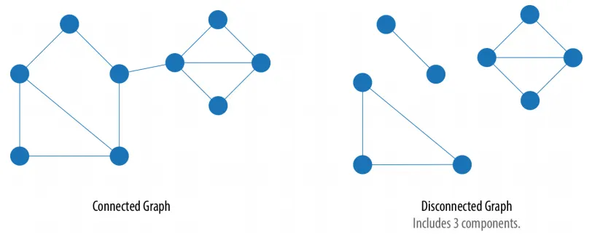
Connected vs. Disconnected Graph

Slide 20
Graph Terminology
A Weighted graph: a graph in which each edge carries a value
Notes:
<number>

Slide 21
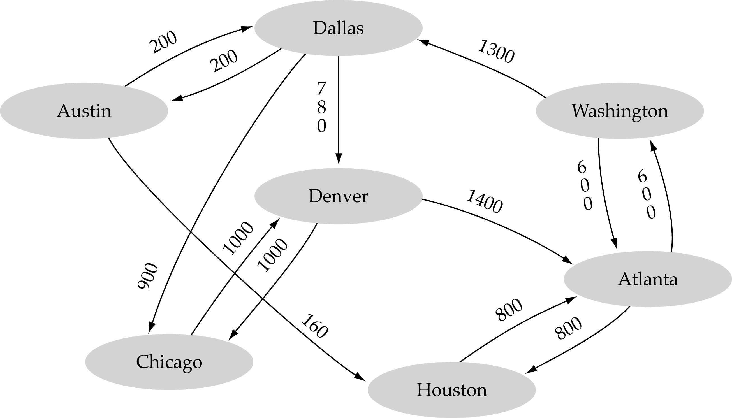
Weighted graph: a graph in which each edge carries a value

Slide 22
A
Find the degree of each vertex.
Is A adjacent to B? Is D adjacent to A? Is E adjacent to itself? Is C adjacent to itself?
Is AB adjacent to BC? Is CE adjacent to BD?
D
C
E
B
Notes:
<number>

Slide 23
Graph implementation
Array-based implementation
A 1D array is used to represent the vertices
A 2D array (adjacency matrix) is used to represent the edges

Slide 24
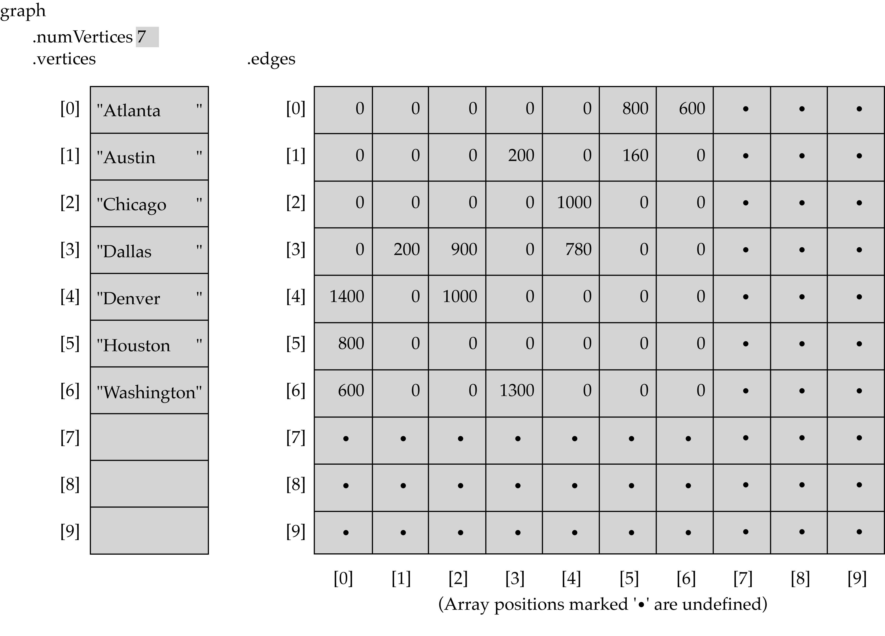
Array-based implementation

Slide 25
Linked-list implementation
A 1D array is used to represent the vertices
A list is used for each vertex v which contains the vertices which are adjacent from v (adjacency list)

Slide 26
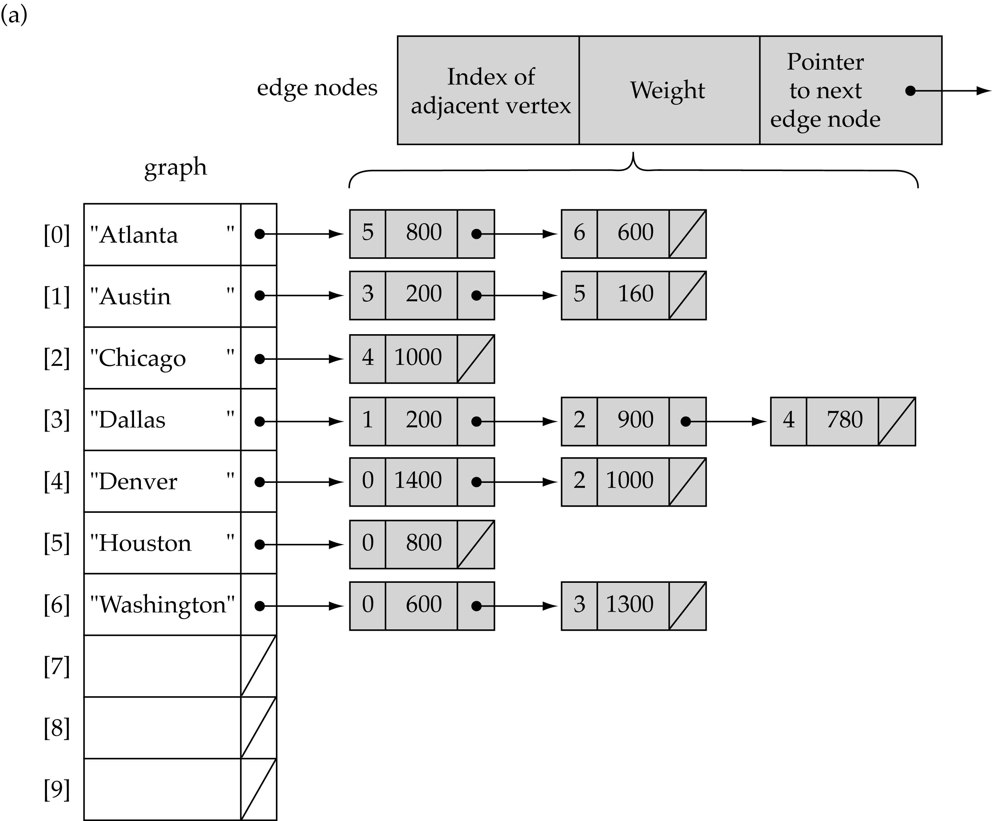
Linked-list implementation

Slide 27
<number>
Graph Representation
For graphs to be computationally useful, they have to be conveniently represented in programs
There are two computer representations of graphs:
Adjacency matrix representation
Adjacency lists representation
CS 103

Slide 28
28
Adjacency Matrix Representation
In this representation, each graph of n nodes is represented by an n x n matrix A, that is, a two-dimensional array A
The nodes are (re)-labeled 1,2,…,n
A[i][j] = 1 if (i,j) is an edge
A[i][j] = 0 if (i,j) is not an edge
CS 103

Slide 29
Adjacency Matrix
1
2
3
4
5
Notes:
<number>

Slide 30
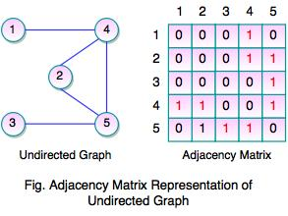
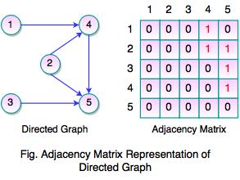
Adjacency Matrix of Directed and Undirected Graph

Slide 31
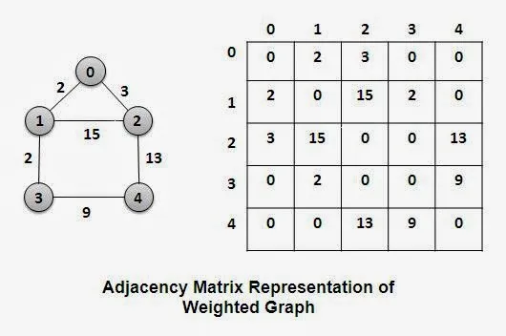
Adjacency Matrix for Weighted Graph

Slide 32
32
Pros and Cons of Adjacency Matrices
Pros:
Simple to implement
Easy and fast to tell if a pair (i,j) is an edge: simply check if A[i][j] is 1 or 0
Cons:
No matter how few edges the graph has, the matrix takes O(n²) in memory
CS 103

Slide 33
32
Adjacency Lists Representation
A graph of n nodes is represented by a one-dimensional array L of linked lists, where
L[i] is the linked list containing all the nodes adjacent from node i.
The nodes in the list L[i] are in no particular order
CS 103

Slide 34
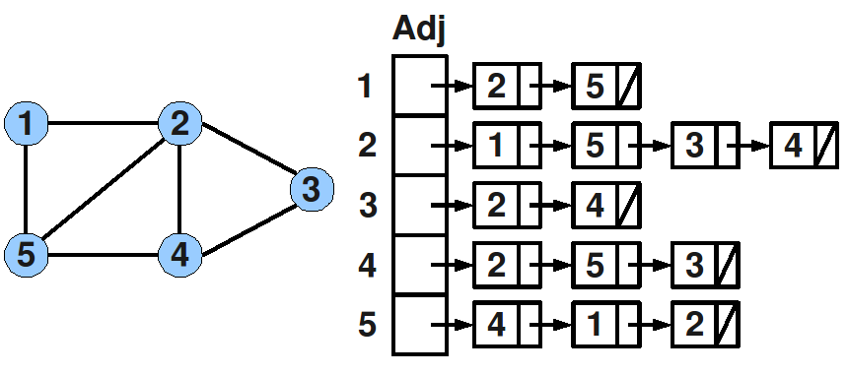
Adjacency Lists Representation

Slide 35
Example(2)
0
0
1
2
1
3
2
0
1
2
3
1
2
3
0
1
2
1
0
2
3
0
2
0
1
3
0
1
2
G1
G2

Slide 36
Example(3)
0
1
2
3
4
5
6
7
1
2
0
4
0
3
2
1
5
0
3
1
2
3
6
5
4
6
7
5
7
6
An undirected graph with n vertices and e edges ==> n head nodes and 2e list nodes

Slide 37
Graph Traversal Orders
Depth-first search (DFS)
- Implemented using Stack
Breadth-first search (BFS)
- Implemented using Queue

Slide 38
Depth-first search (DFS)
Step 1: Initialize each node in G in ready state
Step 2: Push the starting node A on the stack
Step 3: Repeat Steps 4 and 5 until STACK is empty
Step 4: Pop the top node N. Process it and set its status as processed state
Step 5: Push on the stack all the neighbors of N
[END OF LOOP]
Step 6: EXIT

Slide 39
Breadth-first search (BFS)
Step 1: Initialize each node in G in ready state
Step 2: Enqueue the starting node A in the queue
Step 3: Repeat Steps 4 and 5 until queue is empty
Step 4: Dequeue the front element node N. Process it and set its status as processed state
Step 5: Enqueue in the queue all the neighbors of N
[END OF LOOP]
Step 6: EXIT

Slide 40
Graph Traversal Orders
The order we explore the vertices depends upon the data structure used to hold the discovered vertices yet to be fully explored:
Queue - by storing the vertices in a first-in, first out (FIFO) queue, we explore the oldest unexplored vertices first. Thus we radiate out slowly from the starting vertex, defining a so-called breadth-first search.
Stack - by storing the vertices in a last-in, first-out (LIFO) stack, we explore the vertices by constantly visiting a new neighbor if one is available; we back up only when surrounded by previously discovered vertices. This defines a so-called depth-first search.
Notes:
<number>

Slide 41
39
Breadth First Search
2
4
8
s
5
7
3
6
9

Slide 42
<number>
Breadth First Search
Shortest path from s
1
2
2
4
8
0
s
5
7
3
6
9
Undiscovered
Discovered
Queue: s
Top of queue
Finished

Slide 43
<number>
Breadth First Search
1
2
4
8
0
s
5
7
3
3
6
9
1
Undiscovered
Discovered
Queue: s 2
Top of queue
Finished

Slide 44
<number>
Breadth First Search
1
2
4
8
0
s
5
5
7
1
3
6
9
1
Undiscovered
Discovered
Queue: s 2 3
Top of queue
Finished

Slide 45
<number>
Breadth First Search
1
2
4
8
0
s
5
7
1
3
6
9
1
Undiscovered
Discovered
Queue: 2 3 5
Top of queue
Finished

Slide 46
<number>
Breadth First Search
1
2
2
4
4
8
0
s
5
7
1
3
6
9
1
Undiscovered
Discovered
Queue: 2 3 5
Top of queue
Finished

Slide 47
<number>
Breadth First Search
1
2
2
4
8
5 already discovered: don't enqueue
0
s
5
7
1
3
6
9
1
Undiscovered
Discovered
Queue: 2 3 5 4
Top of queue
Finished

Slide 48
<number>
Breadth First Search
1
2
2
4
8
0
s
5
7
1
3
6
9
1
Undiscovered
Discovered
Queue: 2 3 5 4
Top of queue
Finished

Slide 49
<number>
Breadth First Search
1
2
2
4
8
0
s
5
7
1
3
6
9
1
Undiscovered
Discovered
Queue: 3 5 4
Top of queue
Finished

Slide 50
<number>
Breadth First Search
1
2
2
4
8
0
s
5
7
1
3
6
6
9
1
2
Undiscovered
Discovered
Queue: 3 5 4
Top of queue
Finished

Slide 51
<number>
Breadth First Search
1
2
2
4
8
0
s
5
7
1
3
6
9
1
2
Undiscovered
Discovered
Queue: 3 5 4 6
Top of queue
Finished

Slide 52
<number>
Breadth First Search
1
2
2
4
8
0
s
5
7
1
3
6
9
1
2
Undiscovered
Discovered
Queue: 5 4 6
Top of queue
Finished

Slide 53
<number>
Breadth First Search
1
2
2
4
8
0
s
5
7
1
3
6
9
1
2
Undiscovered
Discovered
Queue: 5 4 6
Top of queue
Finished

Slide 54
<number>
Breadth First Search
1
2
2
4
8
0
s
5
7
1
3
6
9
1
2
Undiscovered
Discovered
Queue: 4 6
Top of queue
Finished

Slide 55
<number>
Breadth First Search
1
2
3
2
4
8
8
0
s
5
7
1
3
6
9
1
2
Undiscovered
Discovered
Queue: 4 6
Top of queue
Finished

Slide 56
<number>
Breadth First Search
1
2
3
2
4
8
0
s
5
7
1
3
6
9
1
2
Undiscovered
Discovered
Queue: 4 6 8
Top of queue
Finished

Slide 57
<number>
Breadth First Search
1
2
3
2
4
8
0
s
5
7
7
1
3
3
6
9
1
2
Undiscovered
Discovered
Queue: 6 8
Top of queue
Finished

Slide 58
<number>
Breadth First Search
1
2
3
2
4
8
0
s
5
7
1
3
3
6
9
9
1
2
3
Undiscovered
Discovered
Queue: 6 8 7
Top of queue
Finished

Slide 59
<number>
Breadth First Search
1
2
3
2
4
8
0
s
5
7
1
3
3
6
9
1
2
3
Undiscovered
Discovered
Queue: 6 8 7 9
Top of queue
Finished

Slide 60
<number>
Breadth First Search
1
2
3
2
4
8
0
s
5
7
1
3
3
6
9
1
2
3
Undiscovered
Discovered
Queue: 8 7 9
Top of queue
Finished

Slide 61
<number>
Breadth First Search
1
2
3
2
4
8
0
s
5
7
1
3
3
6
9
1
2
3
Undiscovered
Discovered
Queue: 7 9
Top of queue
Finished

Slide 62
<number>
Breadth First Search
1
2
3
2
4
8
0
s
5
7
1
3
3
6
9
1
2
3
Undiscovered
Discovered
Queue: 7 9
Top of queue
Finished

Slide 63
<number>
Breadth First Search
1
2
3
2
4
8
0
s
5
7
1
3
3
6
9
1
2
3
Undiscovered
Discovered
Queue: 7 9
Top of queue
Finished

Slide 64
<number>
Breadth First Search
1
2
3
2
4
8
0
s
5
7
1
3
3
6
9
1
2
3
Undiscovered
Discovered
Queue: 7 9
Top of queue
Finished

Slide 65
<number>
Breadth First Search
1
2
3
2
4
8
0
s
5
7
1
3
3
6
9
1
2
3
Undiscovered
Discovered
Queue: 9
Top of queue
Finished

Slide 66
<number>
Breadth First Search
1
2
3
2
4
8
0
s
5
7
1
3
3
6
9
1
2
3
Undiscovered
Discovered
Queue: 9
Top of queue
Finished

Slide 67
<number>
Breadth First Search
1
2
3
2
4
8
0
s
5
7
1
3
3
6
9
1
2
3
Undiscovered
Discovered
Queue: 9
Top of queue
Finished

Slide 68
<number>
Breadth First Search
1
2
3
2
4
8
0
s
5
7
1
3
3
6
9
1
2
3
Undiscovered
Discovered
Queue:
Top of queue
Finished

Slide 69
<number>
Breadth First Search
1
2
3
2
4
8
0
s
5
7
1
3
3
6
9
1
2
3
Level Graph

Slide 70
Minimum spanning trees

Slide 71
Definition
A Minimum Spanning Tree (MST) is a subgraph of an undirected graph such that the subgraph spans (includes) all nodes, is connected, is acyclic, and has minimum total edge weight

Slide 72
Algorithm Characteristics
Both Prim’s and Kruskal’s Algorithms work with undirected graphs
Both work with weighted and unweighted graphs but are more interesting when edges are weighted
Both are greedy algorithms that produce optimal solutions

Slide 73
Minimum Connector Algorithms
Kruskal’s algorithm
Select the shortest edge in a network
Select the next shortest edge which does not create a cycle
Repeat step 2 until all vertices have been connected
Prim’s algorithm
Select any vertex
Select the shortest edge connected to that vertex
Select the shortest edge connected to any vertex already connected
Repeat step 3 until all vertices have been connected

Slide 74
Example
A cable company want to connect five villages to their network which currently extends to the market town of Avonford. What is the minimum length of cable needed?
Brinleigh
5
Cornwell
3
4
8
6
8
Avonford
Fingley
Donster
7
5
4
2
Edan

Slide 75
Kruskal’s Algorithm
List the edges in order of size:
ED 2
AB 3
AE 4
CD 4
BC 5
EF 5
CF 6
AF 7
BF 8
DF 8
B
5
C
3
4
8
6
8
A
D
7
F
5
4
2
E

Slide 76
Kruskal’s Algorithm
Select the shortest
edge in the network
ED 2
B
5
C
3
4
8
6
8
A
D
7
F
5
4
2
E

Slide 77
Kruskal’s Algorithm
Select the next shortest
edge which does not
create a cycle
ED 2
AB 3
B
5
C
3
4
8
6
8
A
D
7
F
5
4
2
E

Slide 78
Kruskal’s Algorithm
Select the next shortest
edge which does not
create a cycle
ED 2
AB 3
CD 4 (or AE 4)
B
5
C
3
4
8
6
8
A
D
7
F
5
4
2
E

Slide 79
Kruskal’s Algorithm
Select the next shortest
edge which does not
create a cycle
ED 2
AB 3
CD 4
AE 4
B
5
C
3
4
8
6
8
A
D
7
F
5
4
2
E

Slide 80
Kruskal’s Algorithm
Select the next shortest
edge which does not
create a cycle
ED 2
AB 3
CD 4
AE 4
BC 5 – forms a cycle
EF 5
B
5
C
3
4
8
6
8
A
D
7
F
5
4
2
E

Slide 81
Kruskal’s Algorithm
All vertices have been
connected.
The solution is
ED 2
AB 3
CD 4
AE 4
EF 5
Total weight of tree: 18
B
5
C
3
4
8
6
8
A
D
7
F
5
4
2
E

Slide 82
Prim’s Algorithm
Select any vertex
A
Select the shortest edge connected to that vertex
AB 3
B
5
C
3
4
8
6
8
A
D
7
F
5
4
2
E

Slide 83
Prim’s Algorithm
Select the shortest
edge connected to
any vertex already
connected.
AE 4
B
5
C
3
4
8
6
8
A
D
7
F
5
4
2
E

Slide 84
Prim’s Algorithm
Select the shortest
edge connected to
any vertex already
connected.
ED 2
B
5
C
3
4
8
6
8
A
D
7
F
5
4
2
E

Slide 85
Prim’s Algorithm
Select the shortest
edge connected to
any vertex already
connected.
DC 4
B
5
C
3
4
8
6
8
A
D
7
F
5
4
2
E

Slide 86
Prim’s Algorithm
Select the shortest
edge connected to
any vertex already
connected.
EF 5
B
5
C
3
4
8
6
8
A
D
7
F
5
4
2
E

Slide 87
Prim’s Algorithm
All vertices have been
connected.
The solution is
AB 3
AE 4
ED 2
DC 4
EF 5
Total weight of tree: 18
B
5
C
3
4
8
6
8
A
D
7
F
5
4
2
E

Slide 88
Some points to note
Both algorithms will always give solutions with the same length.
They will usually select edges in a different order – you must show this in your workings.
Occasionally they will use different edges – this may happen when you have to choose between edges with the same length. In this case there is more than one minimum connector for the network.

Slide 89
Kruskal’s Algorithm
Work with edges, rather than nodes
Two steps:
Sort edges by increasing edge weight
Select the first |V| – 1 edges that do not generate a cycle

Slide 90
Walk-Through
Consider an undirected, weight graph
F
3
C
10
A
4
3
8
4
5
B
6
D
4
4
H
2
1
3
G
E
3

Slide 91
Sort the edges by increasing edge weight
F
3
C
edge | d_{v}
(D,E) | 1
(D,G) | 2
(E,G) | 3
(C,D) | 3
(G,H) | 3
(C,F) | 3
(B,C) | 4
edge | d_{v}
(B,E) | 4
(B,F) | 4
(B,H) | 4
(A,H) | 5
(D,F) | 6
(A,B) | 8
(A,F) | 10
10
A
4
3
8
4
5
B
6
D
4
4
H
2
1
3
G
E
3

Slide 92
Select first |V|–1 edges which do not generate a cycle
F
3
C
edge | d_{v}
(D,E) | 1 | √
(D,G) | 2
(E,G) | 3
(C,D) | 3
(G,H) | 3
(C,F) | 3
(B,C) | 4
edge | d_{v}
(B,E) | 4
(B,F) | 4
(B,H) | 4
(A,H) | 5
(D,F) | 6
(A,B) | 8
(A,F) | 10
10
A
4
3
8
4
5
B
6
D
4
4
H
2
1
3
G
E
3

Slide 93
Select first |V|–1 edges which do not generate a cycle
F
3
C
edge | d_{v}
(D,E) | 1 | √
(D,G) | 2 | √
(E,G) | 3
(C,D) | 3
(G,H) | 3
(C,F) | 3
(B,C) | 4
edge | d_{v}
(B,E) | 4
(B,F) | 4
(B,H) | 4
(A,H) | 5
(D,F) | 6
(A,B) | 8
(A,F) | 10
10
A
4
3
8
4
5
B
6
D
4
4
H
2
1
3
G
E
3

Slide 94
Select first |V|–1 edges which do not generate a cycle
F
3
C
edge | d_{v}
(D,E) | 1 | √
(D,G) | 2 | √
(E,G) | 3 | χ
(C,D) | 3
(G,H) | 3
(C,F) | 3
(B,C) | 4
edge | d_{v}
(B,E) | 4
(B,F) | 4
(B,H) | 4
(A,H) | 5
(D,F) | 6
(A,B) | 8
(A,F) | 10
10
A
4
3
8
4
5
B
6
D
4
4
H
2
1
3
G
E
3
Accepting edge (E,G) would create a cycle

Slide 95
Select first |V|–1 edges which do not generate a cycle
F
3
C
edge | d_{v}
(D,E) | 1 | √
(D,G) | 2 | √
(E,G) | 3 | χ
(C,D) | 3 | √
(G,H) | 3
(C,F) | 3
(B,C) | 4
edge | d_{v}
(B,E) | 4
(B,F) | 4
(B,H) | 4
(A,H) | 5
(D,F) | 6
(A,B) | 8
(A,F) | 10
10
A
4
3
8
4
5
B
6
D
4
4
H
2
1
3
G
E
3

Slide 96
Select first |V|–1 edges which do not generate a cycle
F
3
C
edge | d_{v}
(D,E) | 1 | √
(D,G) | 2 | √
(E,G) | 3 | χ
(C,D) | 3 | √
(G,H) | 3 | √
(C,F) | 3
(B,C) | 4
edge | d_{v}
(B,E) | 4
(B,F) | 4
(B,H) | 4
(A,H) | 5
(D,F) | 6
(A,B) | 8
(A,F) | 10
10
A
4
3
8
4
5
B
6
D
4
4
H
2
1
3
G
E
3

Slide 97
Select first |V|–1 edges which do not generate a cycle
F
3
C
edge | d_{v}
(D,E) | 1 | √
(D,G) | 2 | √
(E,G) | 3 | χ
(C,D) | 3 | √
(G,H) | 3 | √
(C,F) | 3 | √
(B,C) | 4
edge | d_{v}
(B,E) | 4
(B,F) | 4
(B,H) | 4
(A,H) | 5
(D,F) | 6
(A,B) | 8
(A,F) | 10
10
A
4
3
8
4
5
B
6
D
4
4
H
2
1
3
G
E
3

Slide 98
Select first |V|–1 edges which do not generate a cycle
F
3
C
edge | d_{v}
(D,E) | 1 | √
(D,G) | 2 | √
(E,G) | 3 | χ
(C,D) | 3 | √
(G,H) | 3 | √
(C,F) | 3 | √
(B,C) | 4 | √
edge | d_{v}
(B,E) | 4
(B,F) | 4
(B,H) | 4
(A,H) | 5
(D,F) | 6
(A,B) | 8
(A,F) | 10
10
A
4
3
8
4
5
B
6
D
4
4
H
2
1
3
G
E
3

Slide 99
Select first |V|–1 edges which do not generate a cycle
F
3
C
edge | d_{v}
(D,E) | 1 | √
(D,G) | 2 | √
(E,G) | 3 | χ
(C,D) | 3 | √
(G,H) | 3 | √
(C,F) | 3 | √
(B,C) | 4 | √
edge | d_{v}
(B,E) | 4 | χ
(B,F) | 4
(B,H) | 4
(A,H) | 5
(D,F) | 6
(A,B) | 8
(A,F) | 10
10
A
4
3
8
4
5
B
6
D
4
4
H
2
1
3
G
E
3

Slide 100
Select first |V|–1 edges which do not generate a cycle
F
3
C
edge | d_{v}
(D,E) | 1 | √
(D,G) | 2 | √
(E,G) | 3 | χ
(C,D) | 3 | √
(G,H) | 3 | √
(C,F) | 3 | √
(B,C) | 4 | √
edge | d_{v}
(B,E) | 4 | χ
(B,F) | 4 | χ
(B,H) | 4
(A,H) | 5
(D,F) | 6
(A,B) | 8
(A,F) | 10
10
A
4
3
8
4
5
B
6
D
4
4
H
2
1
3
G
E
3

Slide 101
Select first |V|–1 edges which do not generate a cycle
F
3
C
edge | d_{v}
(D,E) | 1 | √
(D,G) | 2 | √
(E,G) | 3 | χ
(C,D) | 3 | √
(G,H) | 3 | √
(C,F) | 3 | √
(B,C) | 4 | √
edge | d_{v}
(B,E) | 4 | χ
(B,F) | 4 | χ
(B,H) | 4 | χ
(A,H) | 5
(D,F) | 6
(A,B) | 8
(A,F) | 10
10
A
4
3
8
4
5
B
6
D
4
4
H
2
1
3
G
E
3

Slide 102
Select first |V|–1 edges which do not generate a cycle
F
3
C
edge | d_{v}
(D,E) | 1 | √
(D,G) | 2 | √
(E,G) | 3 | χ
(C,D) | 3 | √
(G,H) | 3 | √
(C,F) | 3 | √
(B,C) | 4 | √
edge | d_{v}
(B,E) | 4 | χ
(B,F) | 4 | χ
(B,H) | 4 | χ
(A,H) | 5 | √
(D,F) | 6
(A,B) | 8
(A,F) | 10
10
A
4
3
8
4
5
B
6
D
4
4
H
2
1
3
G
E
3

Slide 103
Select first |V|–1 edges which do not generate a cycle
F
3
C
edge | d_{v}
(D,E) | 1 | √
(D,G) | 2 | √
(E,G) | 3 | χ
(C,D) | 3 | √
(G,H) | 3 | √
(C,F) | 3 | √
(B,C) | 4 | √
edge | d_{v}
(B,E) | 4 | χ
(B,F) | 4 | χ
(B,H) | 4 | χ
(A,H) | 5 | √
(D,F) | 6
(A,B) | 8
(A,F) | 10
A
3
4
5
B
D
H
2
1
}
3
G
E
not
considered
Done
Total Cost = Σ d_{v} = 21

Slide 104
Dijkstra’s algorithm
Below are the detailed steps used in Dijkstra’s algorithm to find the shortest path from a single source vertex to all other vertices in the given graph.
Algorithm
1) Create a set sptSet (shortest path tree set) that keeps track of vertices included in shortest path tree, i.e., whose minimum distance from source is calculated and finalized. Initially, this set is empty.
2) Assign a distance value to all vertices in the input graph. Initialize all distance values as INFINITE. Assign distance value as 0 for the source vertex so that it is picked first.
3) While sptSet doesn’t include all vertices
….a) Pick a vertex u which is not there in sptSet and has minimum distance value.
….b) Include u to sptSet.
….c) Update distance value of all adjacent vertices of u. To update the distance values, iterate through all adjacent vertices. For every adjacent vertex v, if sum of distance value of u (from source) and weight of edge u-v, is less than the distance value of v, then update the distance value of v.

Slide 105
Walk-Through
2
Initialize array
F
3
C
 | K | d_{v} | p_{v}
A | F | ∞ | −
B | F | ∞ | −
C | F | ∞ | −
D | F | ∞ | −
E | F | ∞ | −
F | F | ∞ | −
G | F | ∞ | −
H | F | ∞ | −
10
A
7
3
8
4
4
B
18
D
9
10
H
2
25
3
G
E
7
d_{v} - distance from D
p_{v} – previous node

Slide 106
2
Start with any node, say D
F
3
C
 | K | d_{v} | p_{v}
A |  | ∞
B |  | ∞
C |  | ∞
D | T | 0 | −
E |  | ∞
F |  | ∞
G |  | ∞
H |  | ∞
10
A
7
3
8
4
4
B
18
D
9
10
H
2
25
3
G
E
7

Slide 107
2
Update distances of adjacent, unselected nodes
F
3
C
 | K | d_{v} | p_{v}
A |  | ∞
B |  | ∞
C |  | 3 | D
D | T | 0 | −
E |  | 25 | D
F |  | 18 | D
G |  | 2 | D
H |  | ∞
10
A
7
3
8
4
4
B
18
D
9
10
H
2
25
3
G
E
7

Slide 108
2
Select node with minimum distance
F
3
C
 | K | d_{v} | p_{v}
A |  | ∞
B |  | ∞
C |  | 3 | D
D | T | 0 | −
E |  | 25 | D
F |  | 18 | D
G | T | 2 | D
H |  | ∞
10
A
7
3
8
4
4
B
18
D
9
10
H
2
25
3
G
E
7

Slide 109
2
Update distances of adjacent, unselected nodes
F
3
C
 | K | d_{v} | p_{v}
A |  | ∞
B |  | ∞
C |  | 3 | D
D | T | 0 | −
E |  | 9 | G
F |  | 18 | D
G | T | 2 | D
H |  | 5 | G
10
A
7
3
8
4
4
B
18
D
9
10
H
2
25
3
G
E
7

Slide 110
2
Select node with minimum distance
F
3
C
 | K | d_{v} | p_{v}
A |  | ∞
B |  | ∞
C | T | 3 | D
D | T | 0 | −
E |  | 9 | G
F |  | 18 | D
G | T | 2 | D
H |  | 5 | G
10
A
7
3
8
4
4
B
18
D
9
10
H
2
25
3
G
E
7

Slide 111
Update distances of adjacent, unselected nodes
2
 | K | d_{v} | p_{v}
A |  | ∞
B |  | 7 | C
C | T | 3 | D
D | T | 0 | −
E |  | 9 | G
F |  | 6 | C
G | T | 2 | D
H |  | 5 | G
F
3
C
10
A
7
3
8
4
4
B
18
D
9
10
H
2
25
3
G
E
7

Slide 112
Select node with minimum distance
2
 | K | d_{v} | p_{v}
A |  | ∞
B |  | 7 | C
C | T | 3 | D
D | T | 0 | −
E |  | 9 | G
F |  | 6 | C
G | T | 2 | D
H | T | 5 | G
F
3
C
10
A
7
3
8
4
4
B
18
D
9
10
H
2
25
3
G
E
7

Slide 113
2
Update distances of adjacent, unselected nodes
F
3
C
 | K | d_{v} | p_{v}
A |  | 9 | H
B |  | 7 | C
C | T | 3 | D
D | T | 0 | −
E |  | 9 | G
F |  | 6 | C
G | T | 2 | D
H | T | 5 | G
10
A
7
3
8
4
4
B
18
D
9
10
H
2
25
3
G
E
7

Slide 114
Select node with minimum distance
2
3
 | K | d_{v} | p_{v}
A |  | 9 | H
B |  | 7 | C
C | T | 3 | D
D | T | 0 | −
E |  | 9 | G
F | T | 6 | C
G | T | 2 | D
H | T | 5 | G
F
C
10
A
7
3
8
4
4
B
18
D
9
10
H
2
25
3
G
E
7

Slide 115
2
Update distances of adjacent, unselected nodes
F
3
C
 | K | d_{v} | p_{v}
A |  | 9 | H
B |  | 7 | C
C | T | 3 | D
D | T | 0 | −
E |  | 8 | F
F | T | 6 | C
G | T | 2 | D
H | T | 5 | G
10
A
7
3
8
4
4
B
18
D
9
10
H
2
25
3
G
E
7

Slide 116
2
Update distances of adjacent, unselected nodes
F
3
C
 | K | d_{v} | p_{v}
A |  | 9 | H
B | T | 7 | C
C | T | 3 | D
D | T | 0 | −
E |  | 8 | F
F | T | 6 | C
G | T | 2 | D
H | T | 5 | G
10
A
7
3
8
4
4
B
18
D
9
10
H
2
25
3
G
E
7

Slide 117
2
Select node with minimum distance
F
3
C
 | K | d_{v} | p_{v}
A |  | 9 | H
B | T | 7 | C
C | T | 3 | D
D | T | 0 | −
E | T | 8 | F
F | T | 6 | C
G | T | 2 | D
H | T | 5 | G
10
A
7
3
8
4
4
B
18
D
9
10
H
2
25
3
G
E
7

Slide 118
2
Update distances of adjacent, unselected nodes
F
3
C
 | K | d_{v} | p_{v}
A | T | 9 | H
B | T | 7 | C
C | T | 3 | D
D | T | 0 | −
E | T | 8 | F
F | T | 6 | C
G | T | 2 | D
H | T | 5 | G
10
A
7
3
8
4
4
B
18
D
9
10
H
2
25
3
G
E
7
Table entries unchanged

Slide 119
Shortest Path from Vertex D to all other Vertices
2
F
3
C
 | K | d_{v} | p_{v}
A | T | 9 | H
B | T | 7 | C
C | T | 3 | D
D | T | 0 | −
E | T | 8 | F
F | T | 6 | C
G | T | 2 | D
H | T | 5 | G
A
3
4
4
B
D
H
2
3
G
E
Done

